Slide 1
3.
combinational multiplier

Slide 2
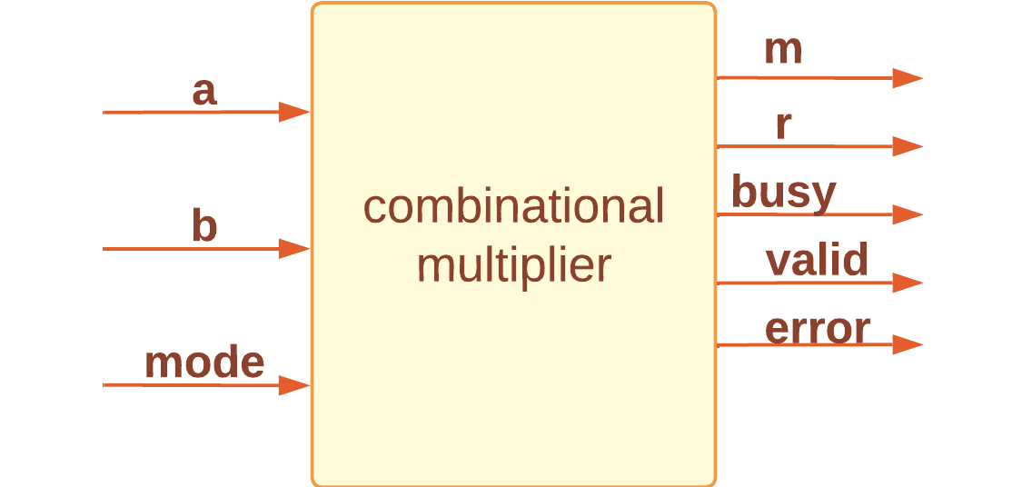
combinational multipier

Slide 3
The ARCHITECTURE of combinational multipier
-This design performs signed binary multiplication using Booth's algorithm.
-The loop iterates N times, where N is the width of the numbers being multiplied.
-If res[1:0]=“01”,a_var is added to res. Then res is shifted right by one bit.
-If res[1:0]=“10”,sub_a is added to res. Then res is shifted right by one bit.
-If res[1:0]=“00” or “11”. res is shifted right by one bit.
-res[2*N :N+1] is assigned to m.
-res[N :1] is assigned to r.
-busy and error are set to 0, and valid is set to 1.

Slide 4
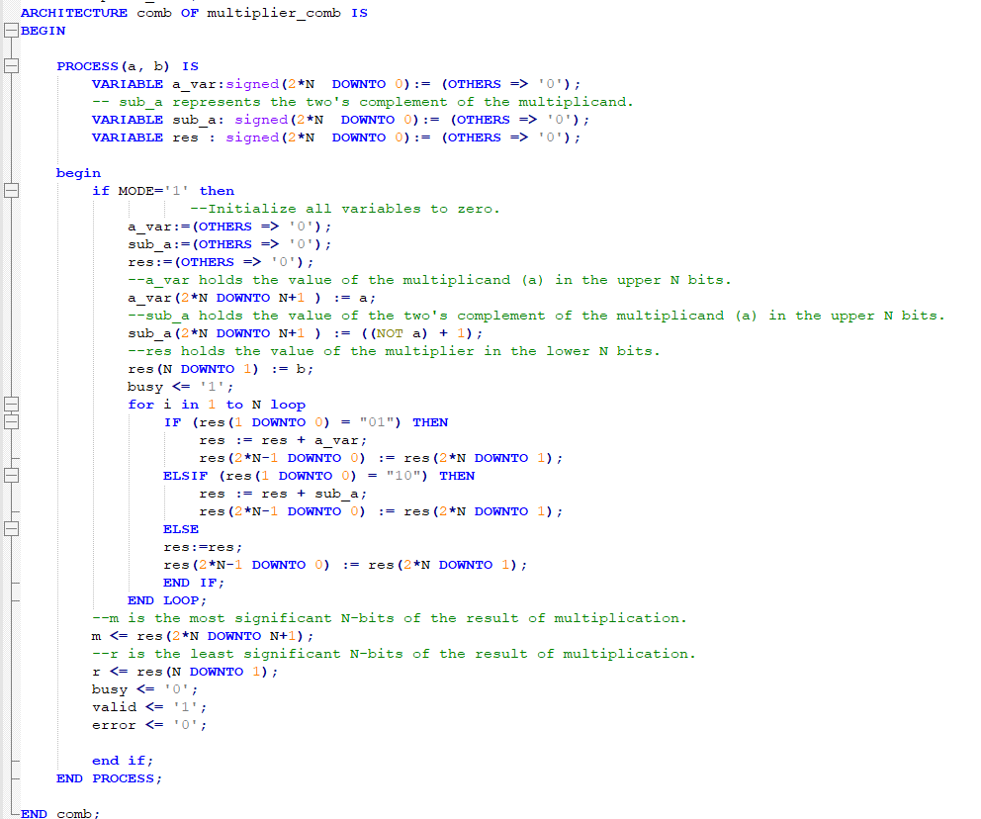
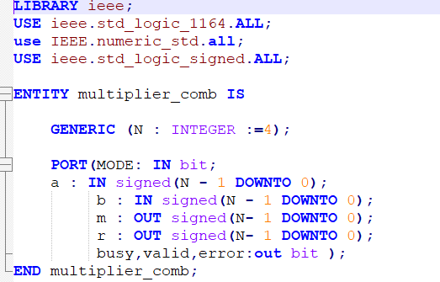
A Screenshot of the code.

Slide 5
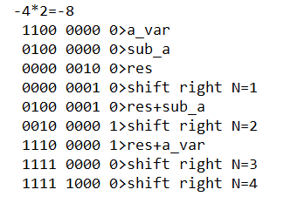
Step-by-Step Example of Booth's algorithm
Initialization: set all variables to zero.
1) a_var = 1100 (-4); this value is stored in the most significant n bits of a_var.
2) sub_a = 0100 (two’s complement of a_var); this value is stored in the most significant n bits of sub_a.
3) res=0010(2); this value is stored in the least significant n bits of res.
4) If res [1:0] equals =00, then res is shifted right by one bit, and N (equals 1).

Slide 6
Step-by-Step Example of Booth's algorithm
5) If res [1:0] equals 10, then res is added to sub_a.
6)res is shifted right by one bit, and N(equals 2).
7) If res [1:0] equals =01, then res is added to a_var.
8)res is shifted right by one bit, and N(equals 3).
9) If res [1:0] equals 00, then res is shifted right by one bit, and N (equals 4)

Slide 7
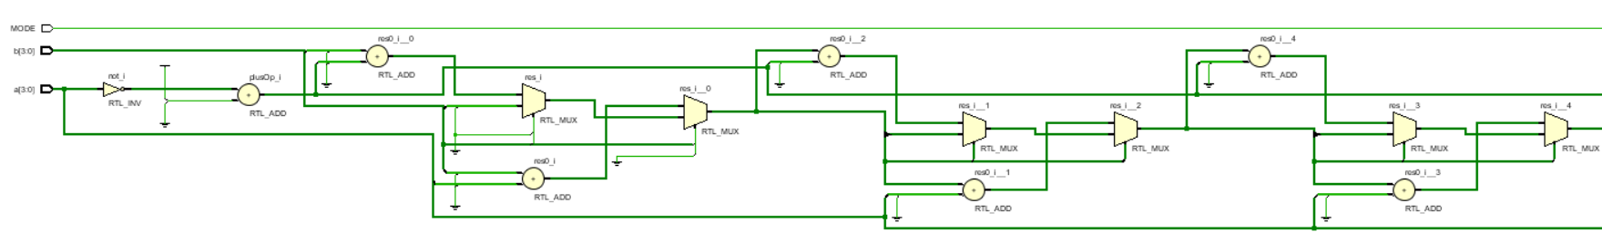
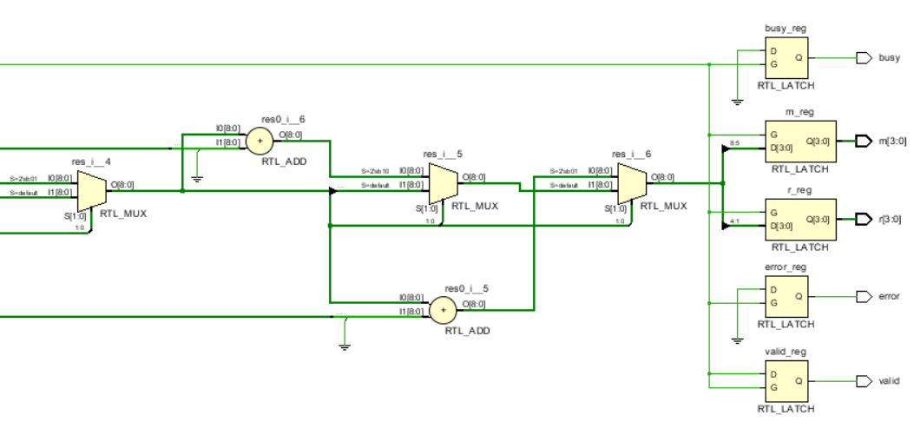
the expected schematic of combinational multiplier

Slide 8
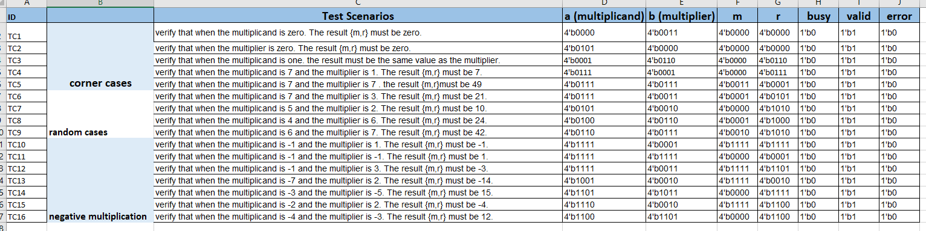
The testbench of combinational multipier
Here is a screenshot of the test scenarios sheet within the verification plan.

Slide 9
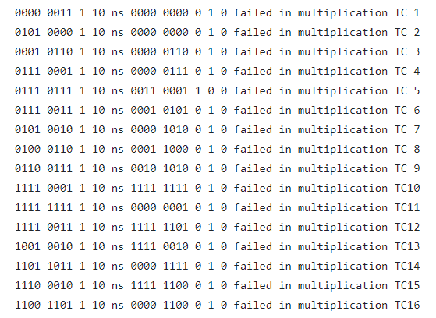
The testbench of combinational multipier
Test cases are read from a file as shown in the following figure.

Slide 10
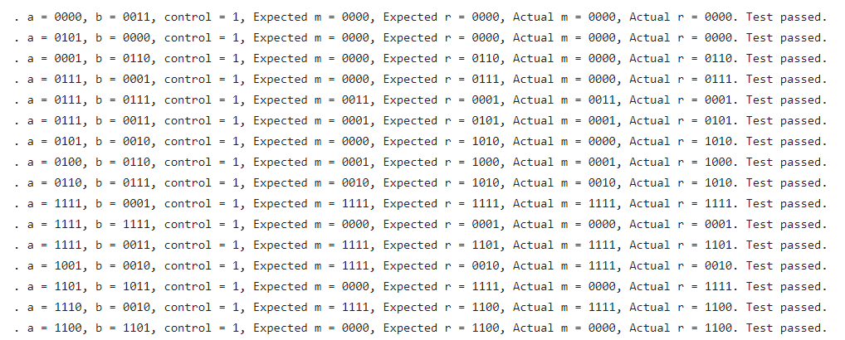
The testbench of combinational multipier
The output of test bench are written in a file as shown in the following figure.
the total number of passed testcases as a ratio from the total testcases

Slide 11
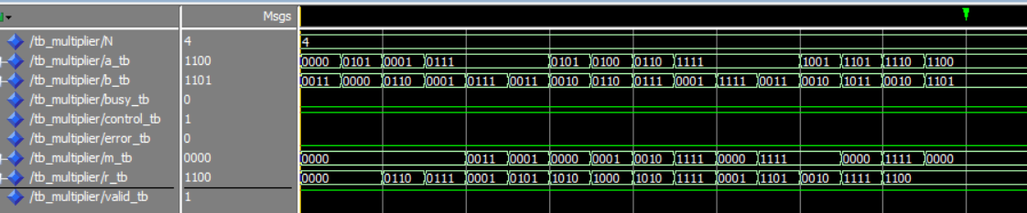
Simulation results

Slide 12
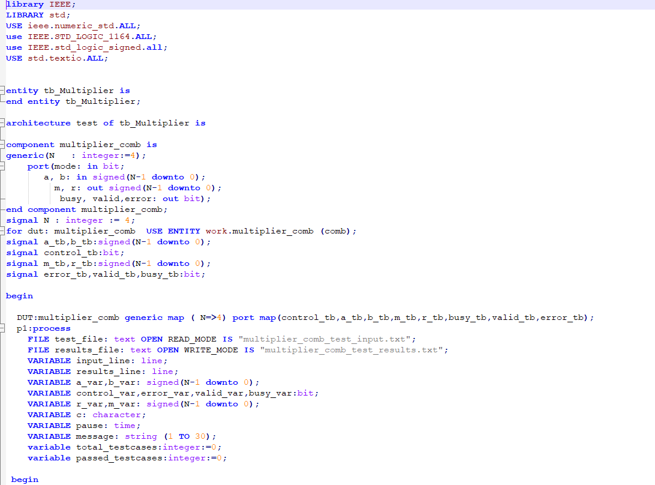
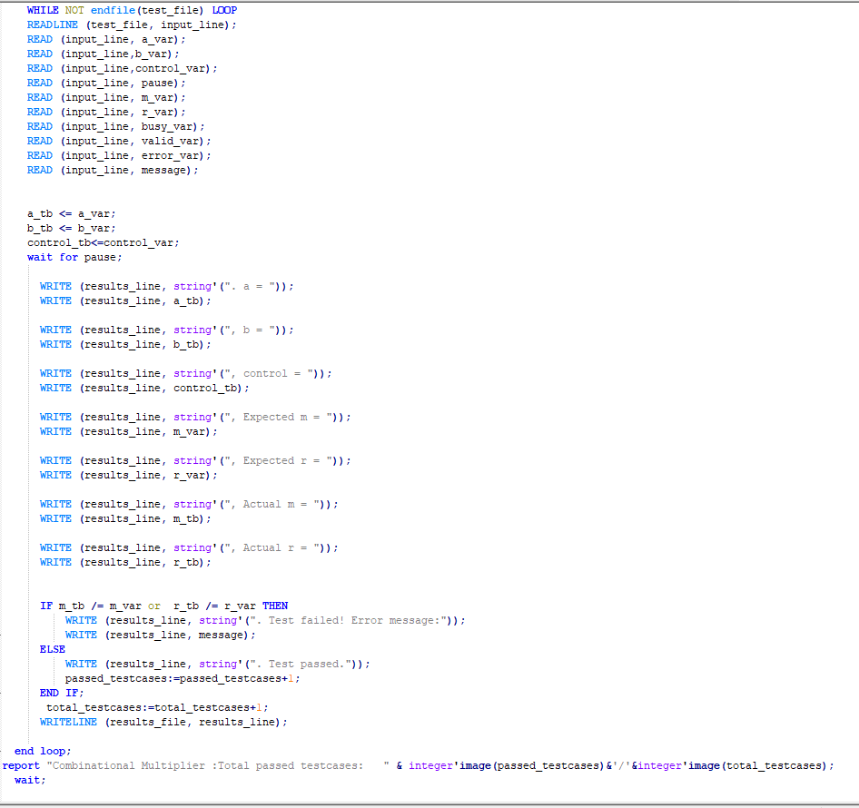
A screenshot of the code

